Slide 1
Smoothing Methods

Slide 2
Smoothing methods
The smoothing methods compute the average of multiple subsets in the time series, with a view to reduce noise (randomness) and make accurate forecasts.

Slide 3
Moving average
Moving average (MA) consists of computing the mean over consecutive subsets or windows of our time series.
This way we get a sequence of averages that approximate the original series. The best way to examine the moving averages is to plot them on the same chart with the initial series.

Slide 4
Moving average
Depending on the window size we can talk about 3-order MA (the averages are computed over 3 periods), 4-order MA etc.
The periods can be days, months, years etc.

Slide 5
Moving average
There are two types of moving average:
centered
trailing

Slide 6
Centered Moving Average

Slide 7
Centered moving average
To compute the centered moving average at the time t, we center the window at that time and calculate the average of the values in the window.
The window size must be an odd number.

Slide 8
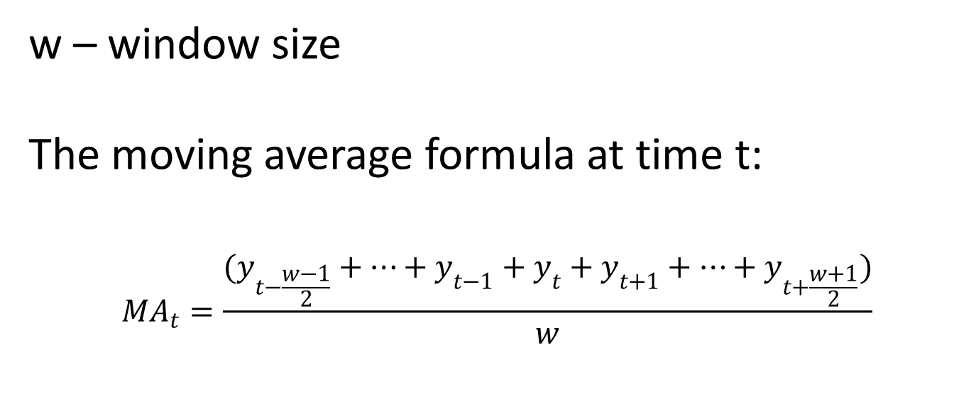
Centered moving average
w – window size
The moving average formula at time t:
$${MA}_{t}=\frac{(y_{t−\frac{w−1}{2}}+…+y_{t−1}+y_{t}+y_{t+1}+…+y_{t+\frac{w+1}{2}})}{w}$$

Slide 9
Centered moving average
Example:
If w = 5, to compute MA_{t} we have to average the values for the following periods: t – 2, t – 1, t, t + 1 and t + 2.

Slide 10
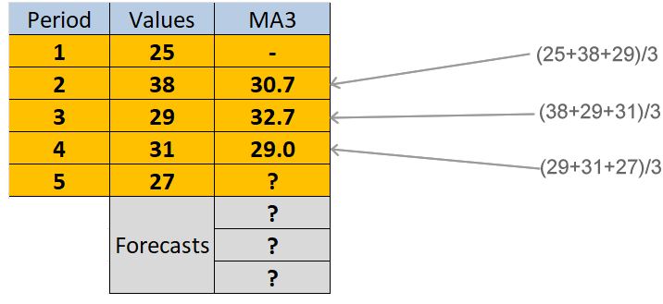
Centered moving average

Slide 11
Centered moving average
If our series presents some seasonality pattern, it is useful to set the window size equal (or approximately equal) to the season length.
(The window size must be an odd number.)

Slide 12
Trailing Moving Average

Slide 13
Trailing moving average
In a trailing moving average, the average is placed at the end of the window.
In this case, the window size can be either an odd or an even number.

Slide 14
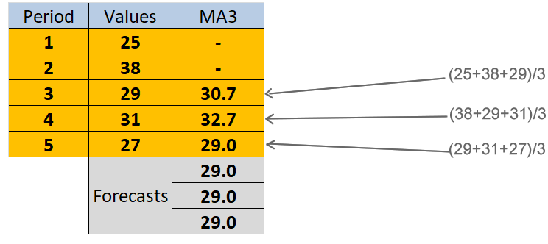
Trailing moving average

Slide 15
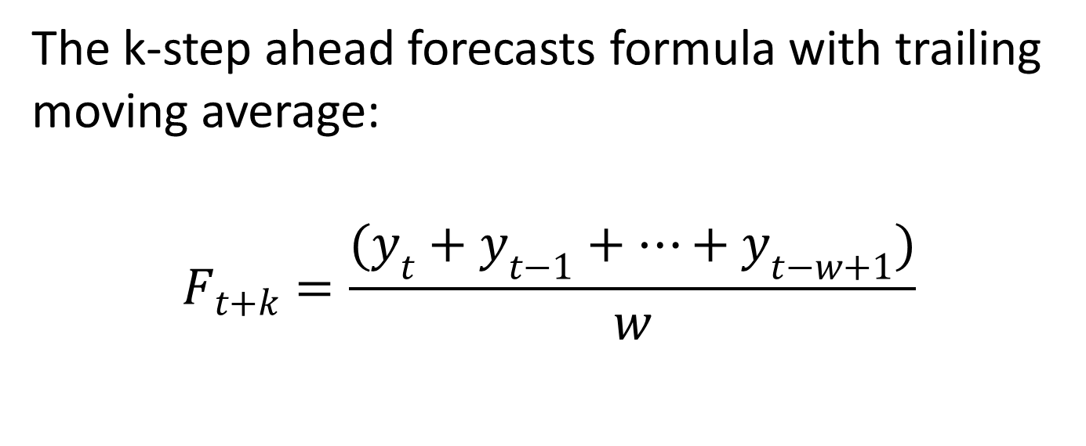
Trailing moving average
The k-step ahead forecasts formula with trailing moving average:
$$F_{t+k}=\frac{(y_{t}+y_{t−1}+…+y_{t−w+1})}{w}$$

Slide 16
Trailing moving average
Particular example:
If we set w = 5, the periods that must be averaged to get the forecasts are: t, t – 1, t – 2,
t – 3 and t – 4 (the last 5 periods).

Slide 17
Weighted Moving Average

Slide 18
Weighted moving average
The weighted moving average method uses weights to calculate the means.
The general rule for setting the weights :
the most recent values have larger weights
the older values have smaller weights
The sum of weights must be 1.

Slide 19
Weighted moving average
This method assumes that recent data have stronger influence on the future values than older data. In consequence, they should carry more weight when making forecasts.
We are going to discuss about the trailing weighted moving averages only.

Slide 20
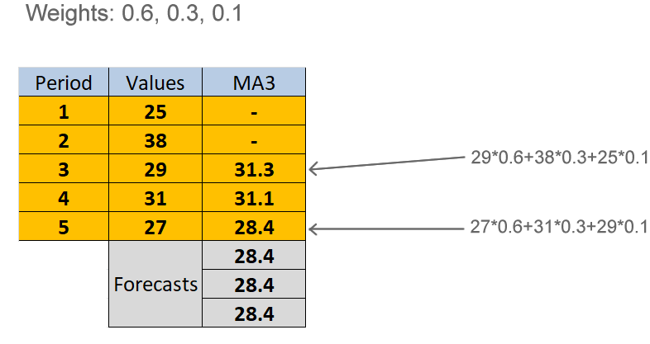
Weighted moving average

Slide 21
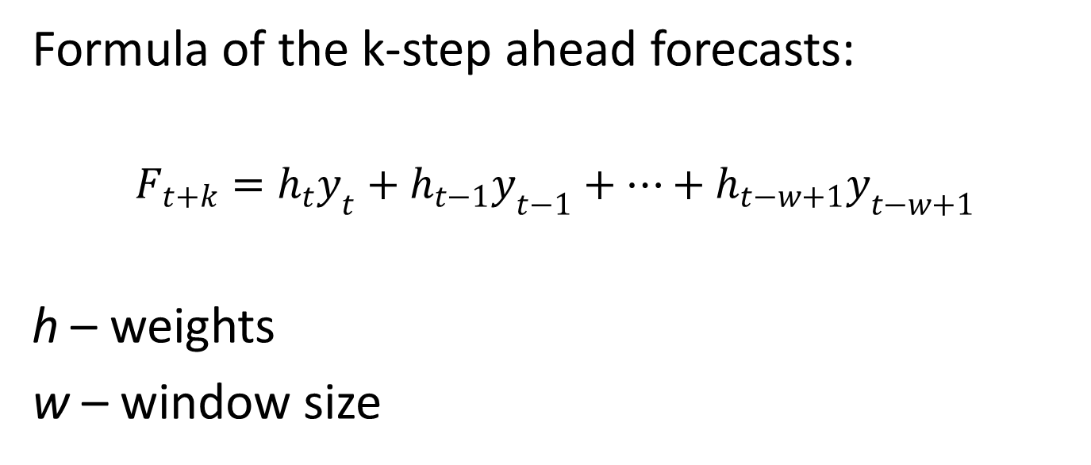
Weighted moving average
Formula of the k-step ahead forecasts:
$$F_{t+k}=h_{t}y_{t}+h_{t−1}y_{t−1}+…+h_{t−w+1}y_{t−w+1}$$
h – weights
w – window size

